Slide 1
Career Cruising
How to find student COMPLETION STATUS reports

Slide 2
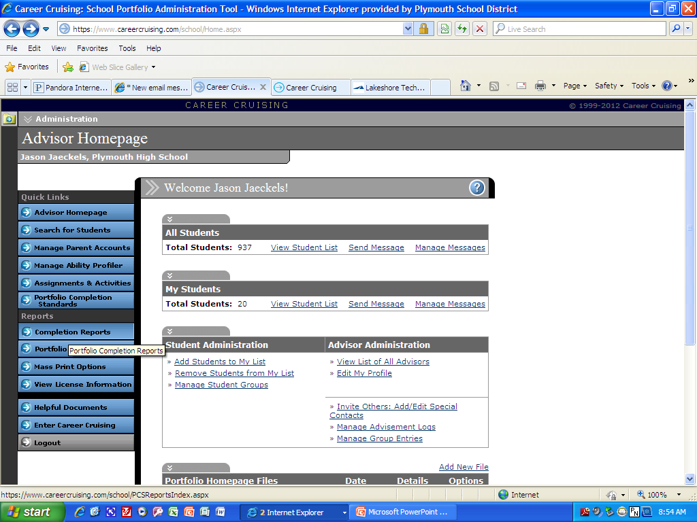
To look at your students COMPLETION REPORTS look under Reports and click on Completion Reports.

Slide 3
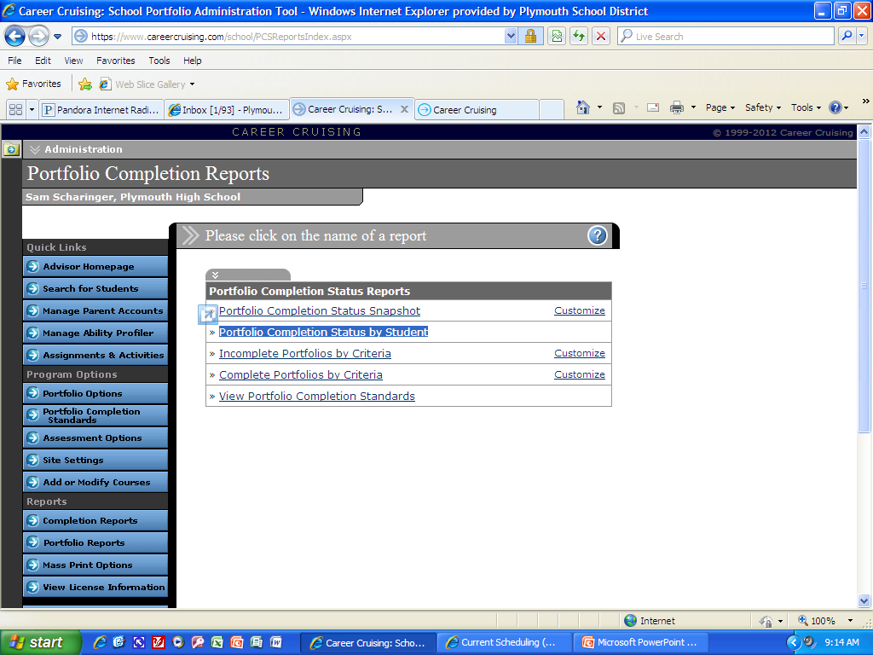
Then Click Portfolio Status by Student

Slide 4
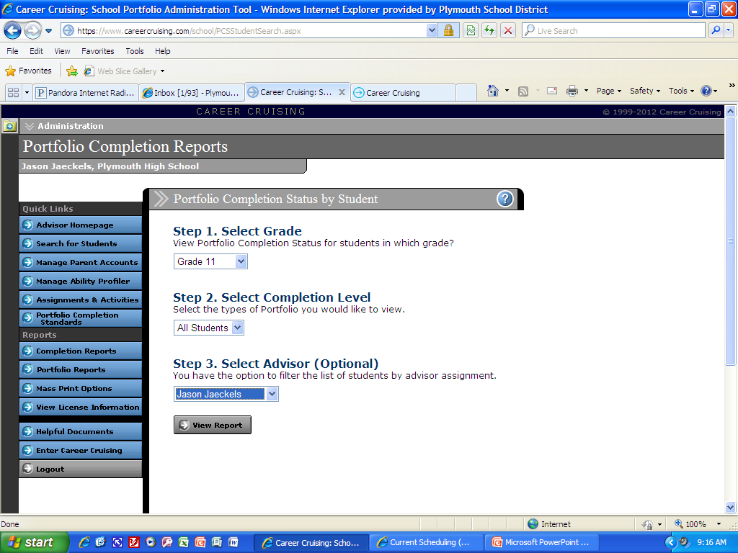
Then select your specific homeroom grade, ALL STUDENTS, and your name as advisor

Slide 5
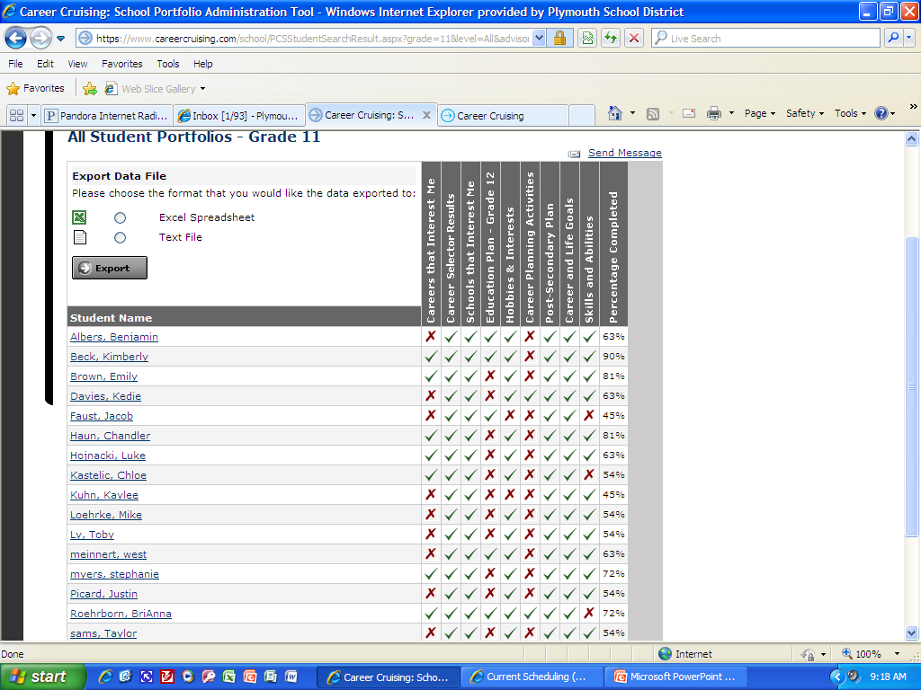
Now you can see by the red X’s what each student has to complete in order to complete 100% each year.

Slide 6
This is a great opportunity to talk further with the specific student about future plans and how they can use career cruising to search some of those questions out!!!
If you have any further questions please contact the counseling staff.

