Slide 1
College Entrance Exams
Welcome Parents & Students
From the PHS Counseling Department

Slide 2
Agenda
ACT
Breakdown of ACT
State requirements
Practice for the ACT
SAT
Breakdown of SAT
Practice for the SAT
Should I take ACT or SAT?
Accuplacer
Breakdown of Accuplacer
Practice for the Accuplacer
Differences between Accuplacer and ACT/SAT
ASVAB
Breakdown of ASVAB

Slide 3
Breakdown of the ACT
The ACT is an achievement test, measuring what a student has learned in school. Achievement tests tend to measure recent learning and are closely tied to particular school subjects.
The ACT is a national college admissions examination that consists of subject area tests in:
English, Math, Reading, Science & an optional Writing part.
ACT results are accepted by all 4-year colleges and universities in the U.S. (and tech schools)
Score Range is 1-36 Points
National Average 21 points
www.phscounselingdept.weebly.com

Slide 4
Breakdown of the ACT continued…
Number of Questions on ACT
English: 75 questions – 45 minutes
Mathematics: 60 questions – 60 minutes
Reading: 40 questions – 35 minutes
Science: 40 questions – 35 minutes
Total: 215 questions - Approx. 4 hours
Writing: 1 prompt – Additional 40 minutes
http://www.actstudent.org/sampletest/

Slide 5
Breakdown of the ACT continued…
ACT (No Writing) $42.50 Includes reports for you, your high school, and up to four college choices.
ACT Plus Writing $58.50 Includes reports for you, your high school, and up to four college choices.
http://www.actstudent.org/regist/actfees.html (For more information)

Slide 6
State Requirements of the ACT
State initiative ALL Juniors will be required to take the ACT with writing
TEST DATE – FEBRUARY 28 , 2017
Location – PHS
Cost –FREE!!!

Slide 7
Tips for taking the ACT
Carefully read the instructions on the cover of the test booklet.
Read the directions for each test carefully.
Read each question carefully.
Pace yourself—don't spend too much time on a single passage or question.
Pay attention to the announcement of five minutes remaining on each test.
Answer the easy questions first, then go back and answer the more difficult ones.
On difficult questions, eliminate as many incorrect answers as you can, then make an educated guess among those remaining.
Answer every question. Your scores on the multiple-choice tests are based on the number of questions you answer correctly. There is no penalty for guessing.
If you complete a test before time is called, recheck your work on that test.

Slide 8
Practice for the ACT
ASPIRE – Is a state initiative that requires PHS Freshman and Sophomores to start being assessed for College and Career readiness.
The Real ACT Prep Guide (ACT website…there is a fee) The official ACT prep guide—the only one that includes three actual retired ACT tests—each with an optional Writing Test.
Preparing for the ACT FREE (Get a copy from PHS Counselor) A free student preparation booklet available from most high schools and colleges—includes test information, complete practice tests with scoring keys, and a sample writing prompt.
UW Sheboygan Prep Courses (fliers on back table)
UW Oshkosh - http://www.uwosh.edu/llce/conted/youth/act-test-prep

Slide 9
Practice for the ACT continued…
NEW ACT PREP Workshop at Plymouth High School
-Saturday, January 9th: 8:00am to noon (pre-test ACT) -Saturday, January 30th: 8:00am to noon (results of ACT pre-test) -Monday, February 1st: 6pm to 8pm (subject work) -Tuesday, February 2nd: 6pm to 8pm (subject work) -Wednesday, February 3rd: 6pm to 8pm (subject work) Cost: $149.00

Slide 10
Practice for the ACT continued…
Free Online Practice Sites:
http://www.testprepreview.com
http://www.internet4classrooms.com/act_sat.htm
www.number2.com
http://www.KnowHow2GOWisconsin.org
http://yescollege.com/2013/04/act-sat-prep/

Slide 11
Registering for ACT
www.actstudent.org

Slide 12
Breakdown for SAT
The SAT
Focus on the knowledge, skills, and understandings that research has identified as most important for college and career readiness and success
Greater emphasis on the meaning of words in extended contexts and on how word choice shapes meaning, tone, and impact
Rights-only scoring (no penalty for guessing)
Scale ranging from 400 to 1600
The SAT has only 3 components: Reading, Writing/Language, Mathematics, and Essay is optional.

Slide 13
Breakdown of the SAT
Reading: 52 Questions - 65 minutes
Writing/Language: 44 Questions – 35 Minutes
Mathematics: 58 Questions – 80 Minutes
Essay: 1 Questions – 50 Minutes
Total: 154 Questions (155 Questions w/ Essay) – 3 hours (Approx. 4 hours w/ Essay)

Slide 14
Breakdown of the SAT continued…
SAT $43.00
SAT with Essay $54.50
https://collegereadiness.collegeboard.org/sat/register

Slide 15
Practicing the SAT
PSAT – taking junior year at PHS (participants will be eligible for the National Merit Scholarship)
http://www.freesatmath.com/
https://collegereadiness.collegeboard.org/sat/practice
http://www.majortests.com/sat/

Slide 16
Registering for SAT
http://sat.collegeboard.org/register/

Slide 17
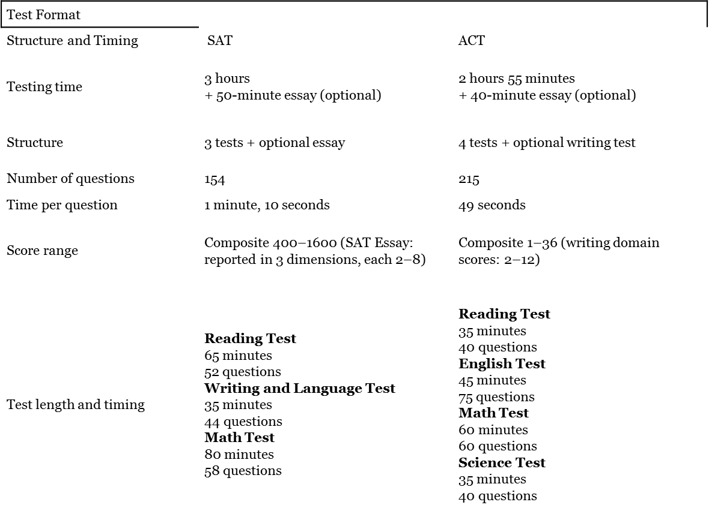
Differences between the ACT and SAT

Slide 18
ACT/SAT Timeline
Elementary Students – 8th Grade students
Academic preparation through everyday curriculum/classes
Read!!! Build your vocabulary
Use websites and smart phone apps
Start building and preparing your mind for the upcoming entrance exams
Freshman – Juniors
Academic perpetration through everyday curriculum/classes
READ!!! Keep building your vocabulary
ASPIRE/PSAT
Use websites and smart phone apps
The more you practice the more you remember
“Muscle memory!!!”

Slide 19
Breakdown of the Accuplacer
ACCUPLACER is a suite of tests that determines your knowledge in math, reading and writing.
Primarily to enter Technical Colleges
Arithmetic: 17 multiple-choice questions
Whole Numbers and Fractions (add, subtract, multiply, divide, estimate, equivalent fractions)
Decimals and Percents (add, subtract, multiply, divide, percents, fraction/decimal equivalents)
Applications and Problem Solving (rate, percent, measurement problems, geometry)
Elementary Algebra: 12 multiple-choice questions
(only required for Electro-Mechanical Technology, Energy Management Technology, Environmental Engineering - Waste & Water Technology; Industrial Electrician Apprentice; Maintenance Technician Apprentice; Mechanical Design; Nuclear Technology; Plumber; Sheet Metal Apprentice; and Wind Energy Technology).
Reading Comprehension: 20 multiple-choice questions
Identifying Main Ideas
Direct Statements and Secondary Ideas
Inferences
Applications
Sentence Relationships
Sentence Skills: 20 multiple-choice questions
Recognizing Complete Sentences
Coordination and Subordination
Clear Sentence Logic

Slide 20
Breakdown of the Accuplacer continued…
NOT a timed test
The cost is $20. Retests are $10. Cash or check only.

Slide 21
Practice for the Accuplacer
http://gotoltc.edu/how-to-apply/testing-services-accuplacer/accuplacer/index.html
https://accuplacer.collegeboard.org/

Slide 22
Differences between Accuplacer and ACT/SAT
Technical Schools vs College/University
Not a timed test
Tests depends on area of study
Computer based test with no recalling questions

Slide 23
Breakdown of the ASVAB
The Armed Services Vocational Aptitude Battery is a multiple-choice test that helps you better understand your strengths and is one of the things that helps identify which Military jobs (Military Occupational Specialties) are best for you.
ASVAB results can be used for vocational and career planning, even if you decide not to join the military.

Slide 24
Breakdown of ASVAB continued…
ASVAB TEST AREAS
General Science - measures knowledge of life science, earth and space science, and physical science
Arithmetic Reasoning - measures ability to solve basic arithmetic word problems
Word Knowledge - measures ability to understand the meaning of words through synonyms
Paragraph Comprehension - measures ability to obtain information from written material
Mathematics Knowledge - measures knowledge of mathematical concepts and applications
Electronics Information - measures knowledge of electrical current, circuits, devices, and electronic systems
Auto and Shop Information - measures knowledge of automotive maintenance and repair, and wood and metal shop practices
Mechanical Comprehension - measures knowledge of the principles of mechanical devices, structural support, and properties of materials
Assembling Objects - measures ability with spatial relationships

Slide 25
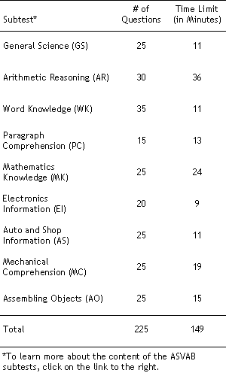
Breakdown of the ASVAB continued…

Slide 26
Breakdown of the ASVAB continued…
http://official-asvab.com/whattoexpect_app.htm
Test is FREE

Slide 27
LAST SLIDE!!!
Thanks for coming! Please check out the Counseling website if you have further questions!
http://phscounselingdept.weebly.com/

